Slide 1

The mystery of a good wine…

Slide 2
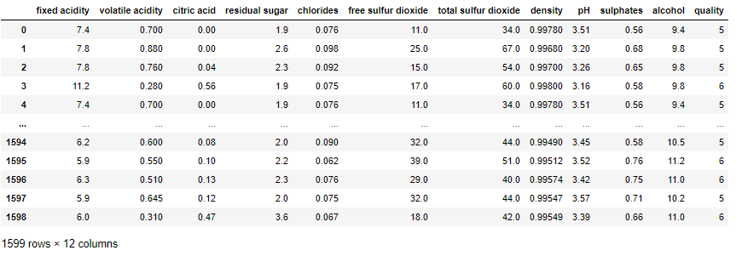
Data Set
Data Set comes from Kaggle and contain information about Portuguese red wines („Vinho Verde”).
Source: https://www.kaggle.com/uciml/red-wine-quality-cortez-et-al-2009

Slide 3
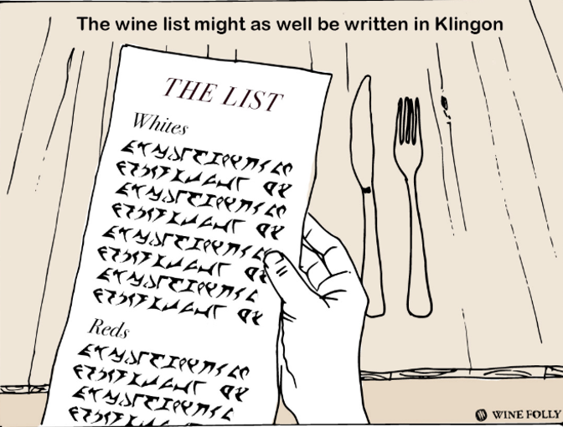
Features
fixed acidity: most acids in with wine
volatile acidity: acetic acid, at too high of levels can lead to an unpleasant, vinegar taste
citric acid: in small quantities can add ‘freshness’ and flavor to wines
residual sugar: the amount of sugar remaining after fermentation stops (45 g/l - sweet)
chlorides: the amount of salt in the wine
free sulfur dioxide: the free form of SO2 prevents microbial growth and the oxidation of wine
total sulfur dioxide: amount of free and bound forms of S02, detectable in taste when > 50 ppm
density: depends on the percent alcohol and sugar content
pH: describes how acidic 0 (very acidic) or alkaline 14 (very alkaline), most wines are between 3-4pH
sulphates: an additive which acts as an antimicrobial and antioxidant, allergenic
alcohol: the percent alcohol content of the wine

Slide 4
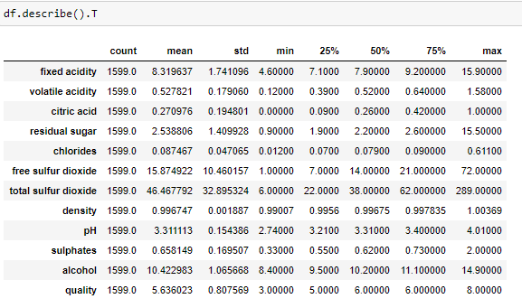
Data Set -
Observations
Mean residual sugar level is 2.5 g/l, but there is a sample of wine with 15.5 g/l (which is still not sweet as noticeably sweet wines start at around 35 g/l)
Mean free sulfur dioxide is 46.5 ppm. Max value is 289 which is quite high as 75% is 62 ppm. (max. By law in US is 350)
PH of wine is within range from 2.7 till 4, mean 3.3. There is no basic wines in this dataset (no high pH levels).
Alcohol: lightest wine is 8.4%, strongest is 14.9.
Min. quality mark is 3, mean 5.8, highest is 9.

Slide 5
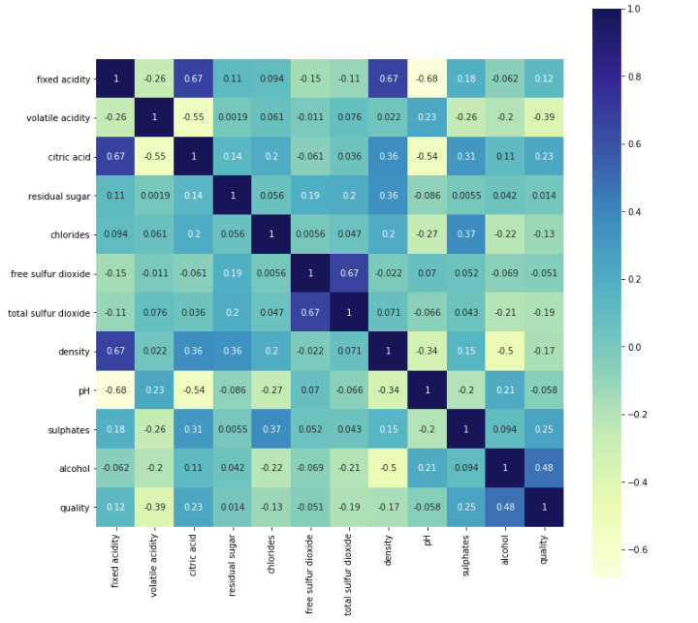
Data Set -
Observations
The quality of wine is the most corelated to the amount of alcohol
The quality of wine is highly inversly related to volatile acidity
The quality increase with amount of sulphates

Slide 6
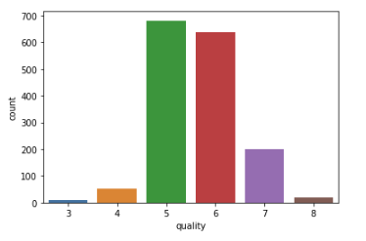
Data Set - observations

Slide 7
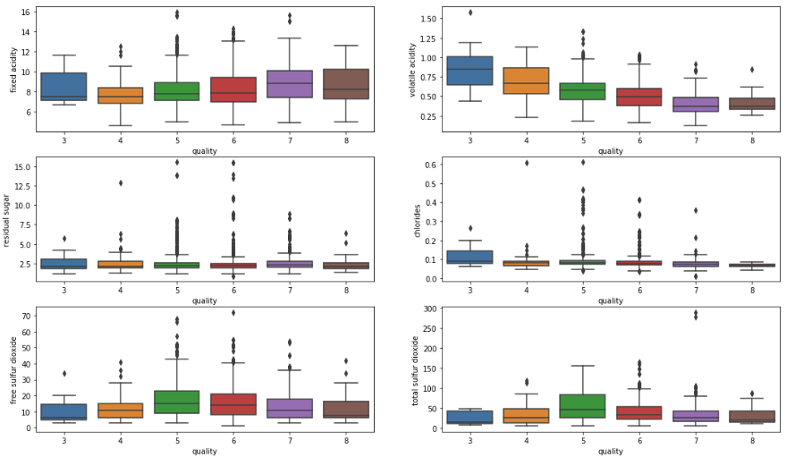
Features value vs Quality

Slide 8
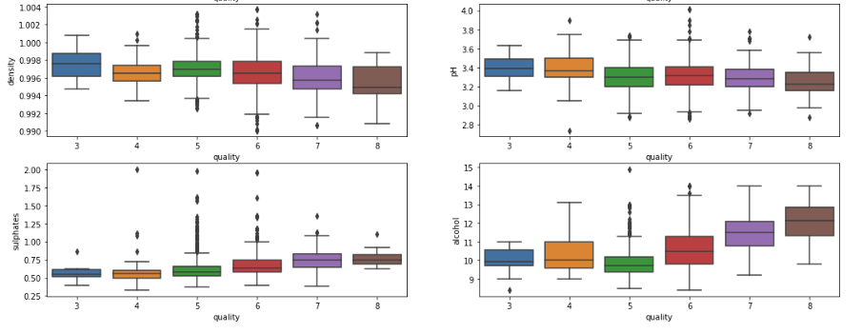
Features value vs Quality

Slide 9
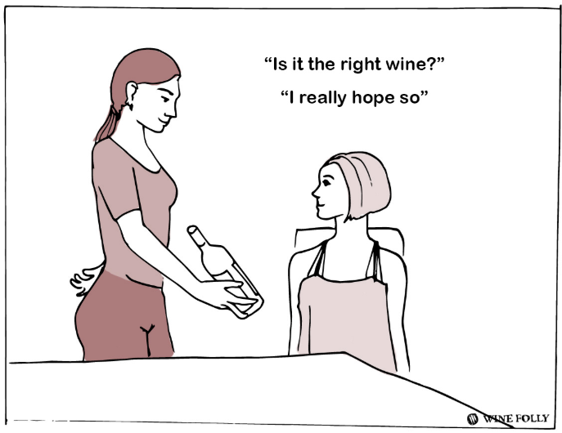
Model buildig
Goal:
We will try to build a model that will be able to classify good and bad wines.
Wines with a quality score of 5 or higher will be considered as "good" wines with with a quality score of less will be considered as "bad" wines.

Slide 10
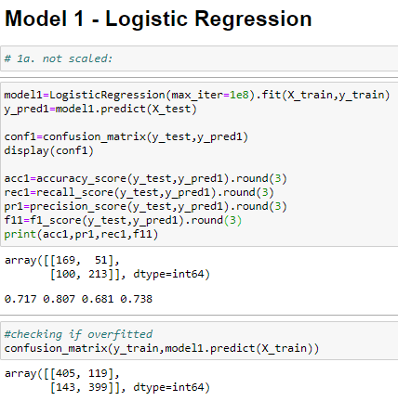

Slide 11
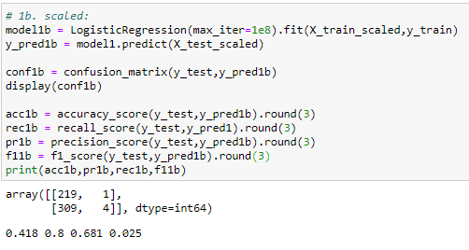

Slide 12
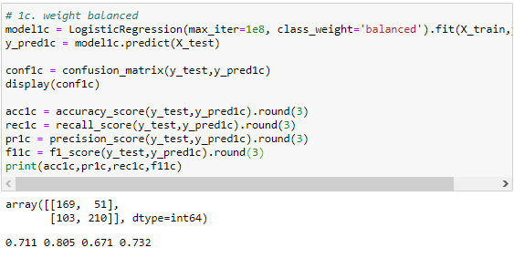

Slide 13
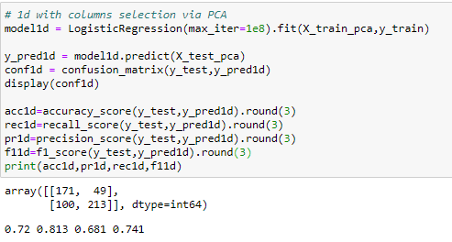

Slide 14
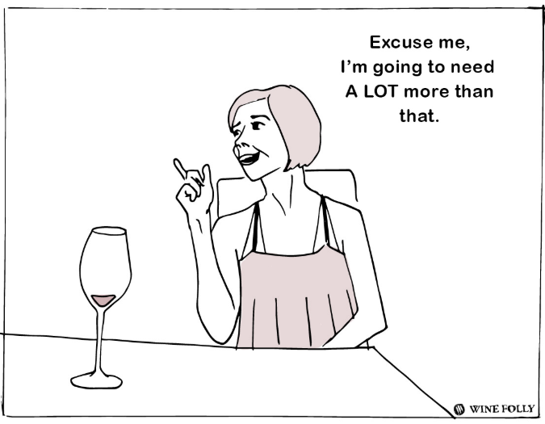

Slide 15
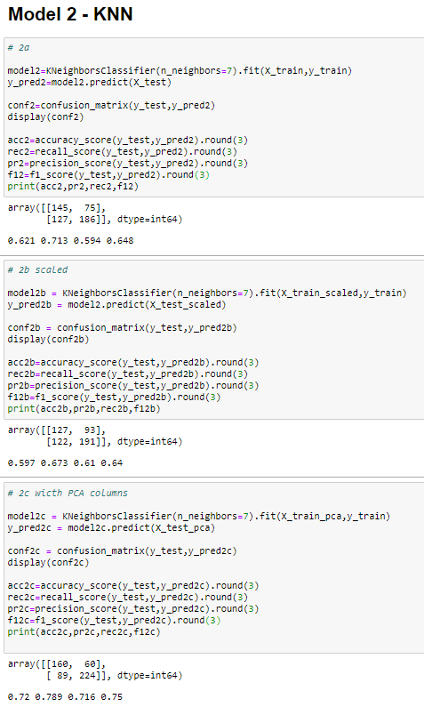
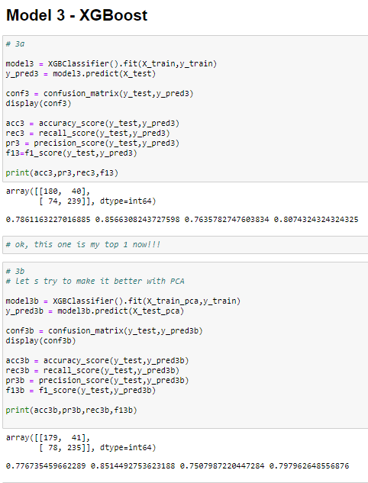

Slide 16
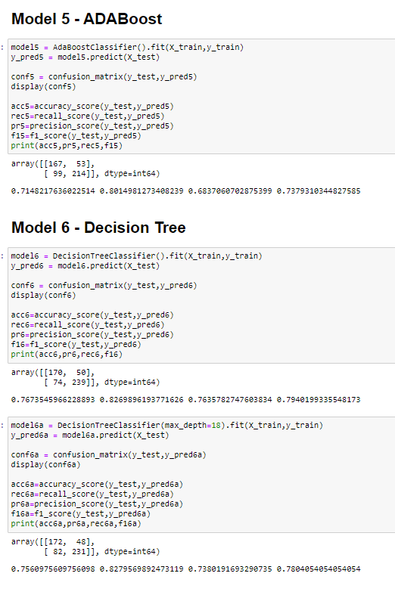
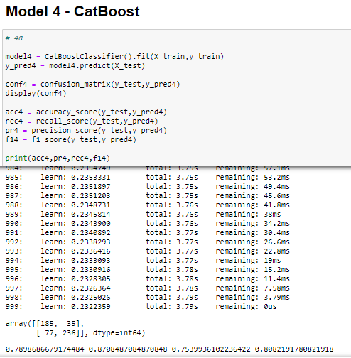

Slide 17
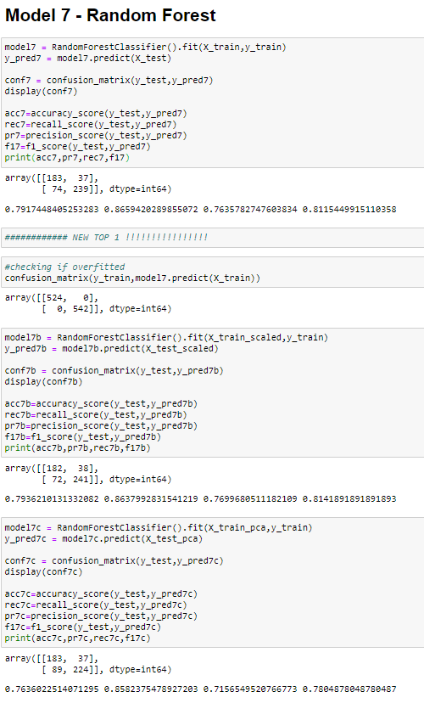

Slide 18
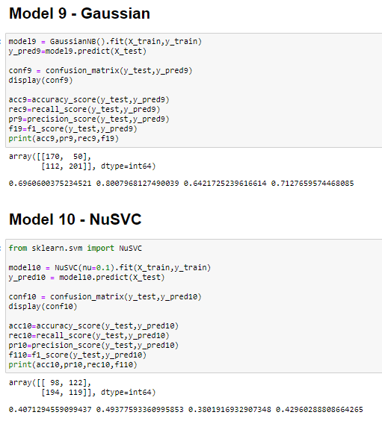

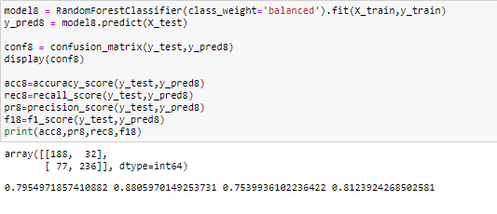

Slide 19
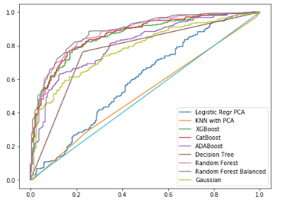
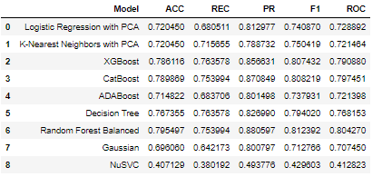
Models accuracy summary
ROC_AUC_SCORE:

Slide 20

Model summary
Accuracy of 79,5%
Model evaluated 424 wines correctly, 32 as false good and 77 as false bad

Slide 21
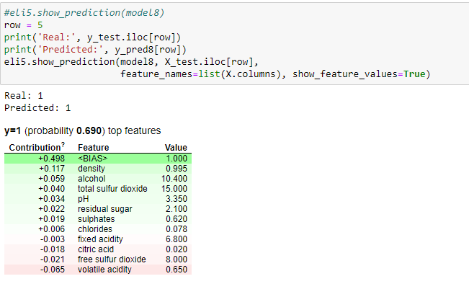
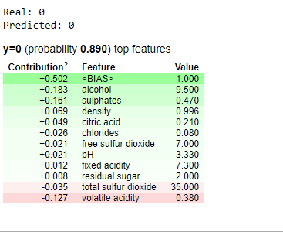
Model summary
prediction = bias + feature1 *contribution+…+feature n *contribution

Slide 22
Cheers!

